Slide 1
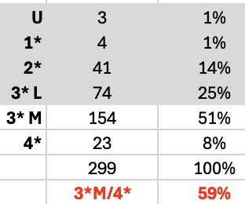
CS REF outputs review round 2
299 outputs reviewed (17 rolled over)
Target 159
REF2021 decisions based on average of 2 reviews per output
REF2029 decisions based on 3 reviews per output
Average gives us this:
Average is too high (2.5 years to go)

Slide 2
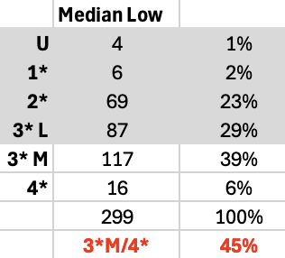
Alternative calculation
Median low (mid point of 2 lowest scores)
133 3*M /4* OK, but with 2.5 years to go, still too high

Slide 3
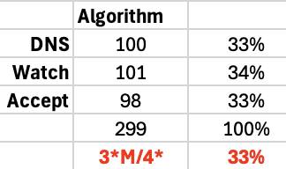
An algorithm
1. Calculate median low scores
2. Calculate normalised scores (average)
3. Compare normalised score with median low score
4. ACCEPT outputs with “solid” scores, i.e.,
3* medium (8) and above with no score below 8 on either count
3* medium (8) and above on overall quality score on both counts, and FWCI more than 1.25 & more than 10 citations
5. DO NOT SUBMIT (DNS)
U, 1* or 2* on both counts
2* median low (4, 5 or 6) / 3* normalised low (7)
any 3* low (7) on both counts with FWCI less than 1 & less than 10 citations * (excluding recently published outputs)
6. WATCH all others
See if metrics improve

Slide 4
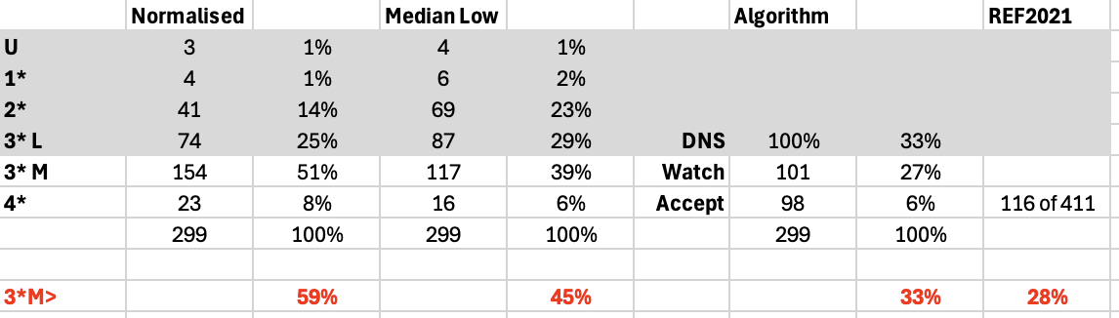
Various calculations

Slide 5
What’s next?
Enter rolling review period (heads of research announce to staff)
DoR debrief research groups
Groups, next action
  Review outputs labelled DNS: authors have opportunity to provide strong factual evidence of significance to rebut (see next slide) (Deadline: mid-2028 TBC)

Slide 6
Evidence of significance
Recognition. Best Paper Award, Honourable Mention or some other Prize for Research that is directly attributable to the output. Include a URL to provide verifiable evidence, e.g., https://programs.sigchi.org/chi/2026/awards/best-papers
Impact on the state of the art. Provide evidence of uptake by the research community. Go and look at who is citing the output and why. Briefly explain how the research reported in the output has influenced the research community. Include a selection of DOIs to the most significant use cases to provide verifiable evidence. Use the URL format for DOIs, e.g., https://doi.org/10.1080/07370024.2025.2475743
Further developments. Provide evidence that the research reported in the output has shaped and informed further work:
  international collaborations producing further research outputs of significance (provide DOIs)
  input into / influence on policy or regulation, inc. professional bodies (provide URLs)
  the award of research grants including value and funder reference (provide URLs to grant in funder database)
Application. Provide evidence that the research has been taken up, applied and / or used by parties outside of academia. This may include industry, NGOs (inc. charities) or government agencies local, national or international. Include URLs and / or contact details for someone who can verify their organisation has taken up, applied and / or used the research.
Do not provide citation data, conference acceptance rate, journal impact factor, or any other bibliometric

